Slide 1

STUDENT REGISTRATION WEBSITE Department of Computer Science and Technology
Prepared By :
Snehashis Sadhukhan
Sourav Halder
Avijit Biswas
Kaniska Das
Rabi Ghosh
Tamal Paul

Slide 2
INTRODUCTION
The Student Registration Website is a web-based portal developed in XAMPP Server. It can be used by educational institutes or colleges to maintain the records of students easily who are registering with their details for admission in the colleges and schools. This Project consists of five functional webpages: an enhanced Personal Details Input, Academic Details Input, Searching and modifying Personal data, Searching and modifying Academic data and the last one is Printing Student's Registration Certificate. The project provides facilities like registration and profile creation of students thus reducing paperwork and automating the record generation process in an educational institution.

Slide 3
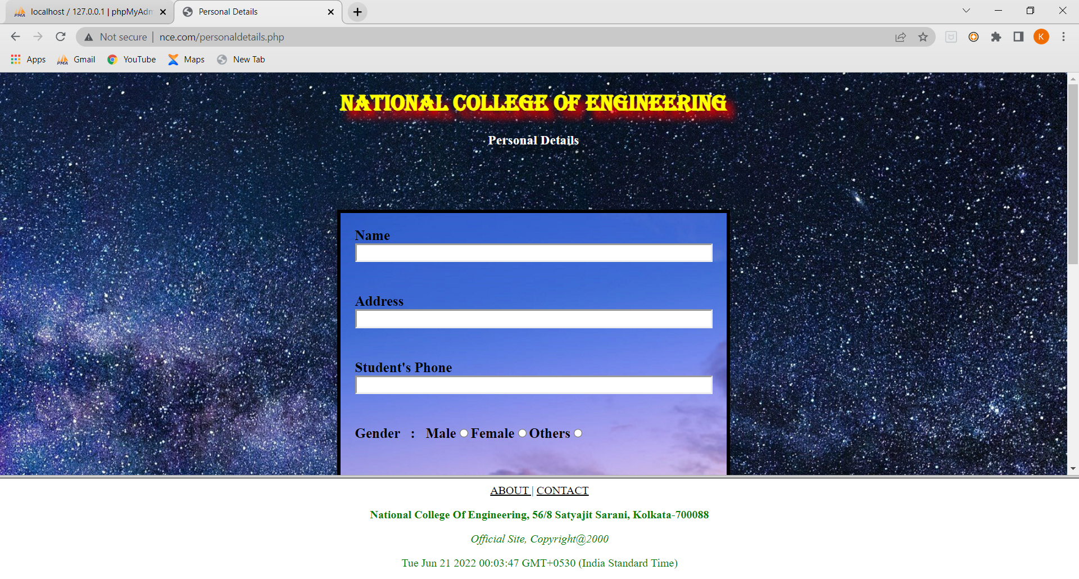
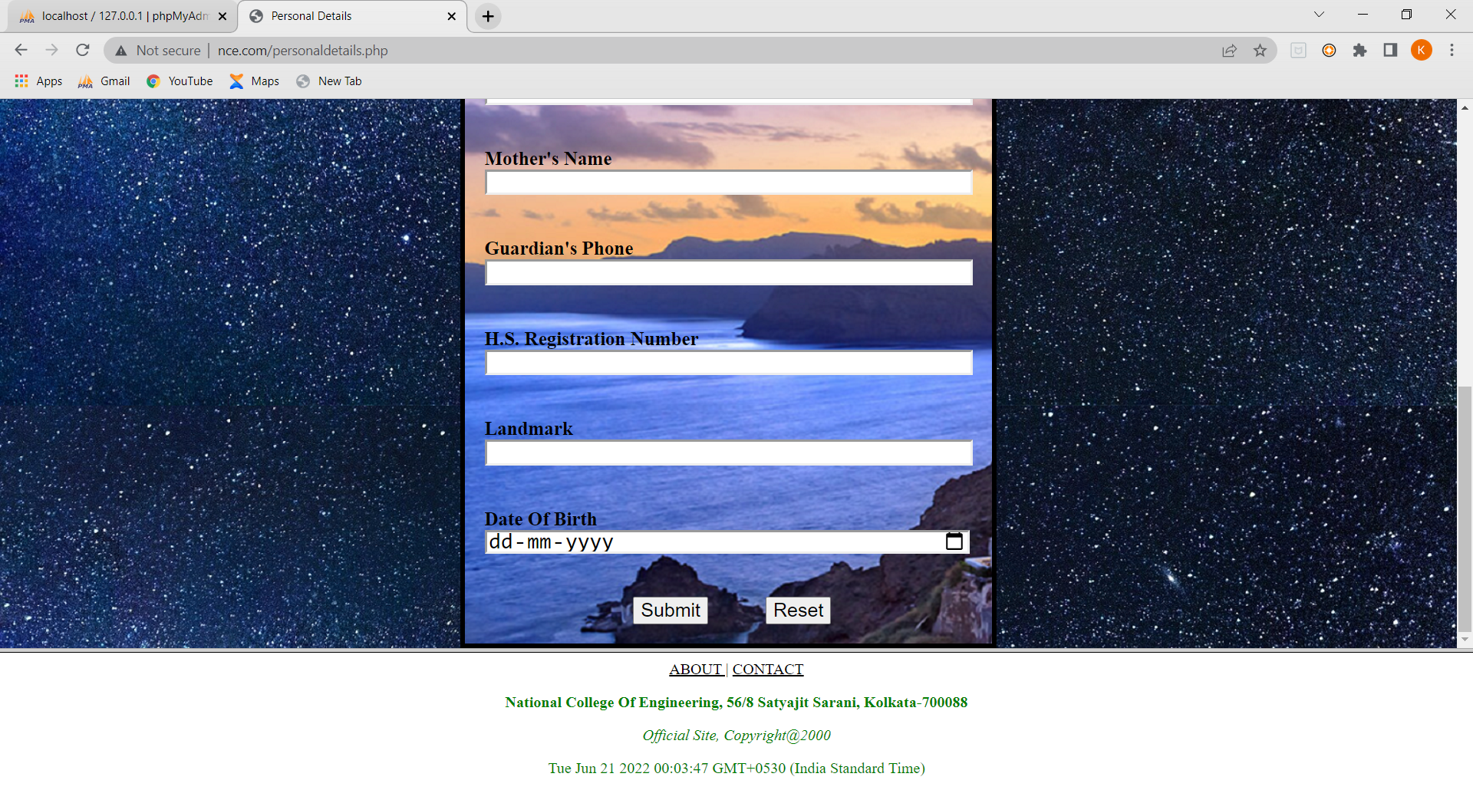
Personal Details
This webpage has been developed with HTML, CSS and JavaScript.
Several personal data are to be asked from the user.
The data includes Name, Address, Gender, Student’s phone, Father’s name, Mother’s name, Guardian’s phone, H.S. Registration number, Landmark, Date of Birth.
After clicking Submit button, all data would be uploaded to the Database.

Slide 4
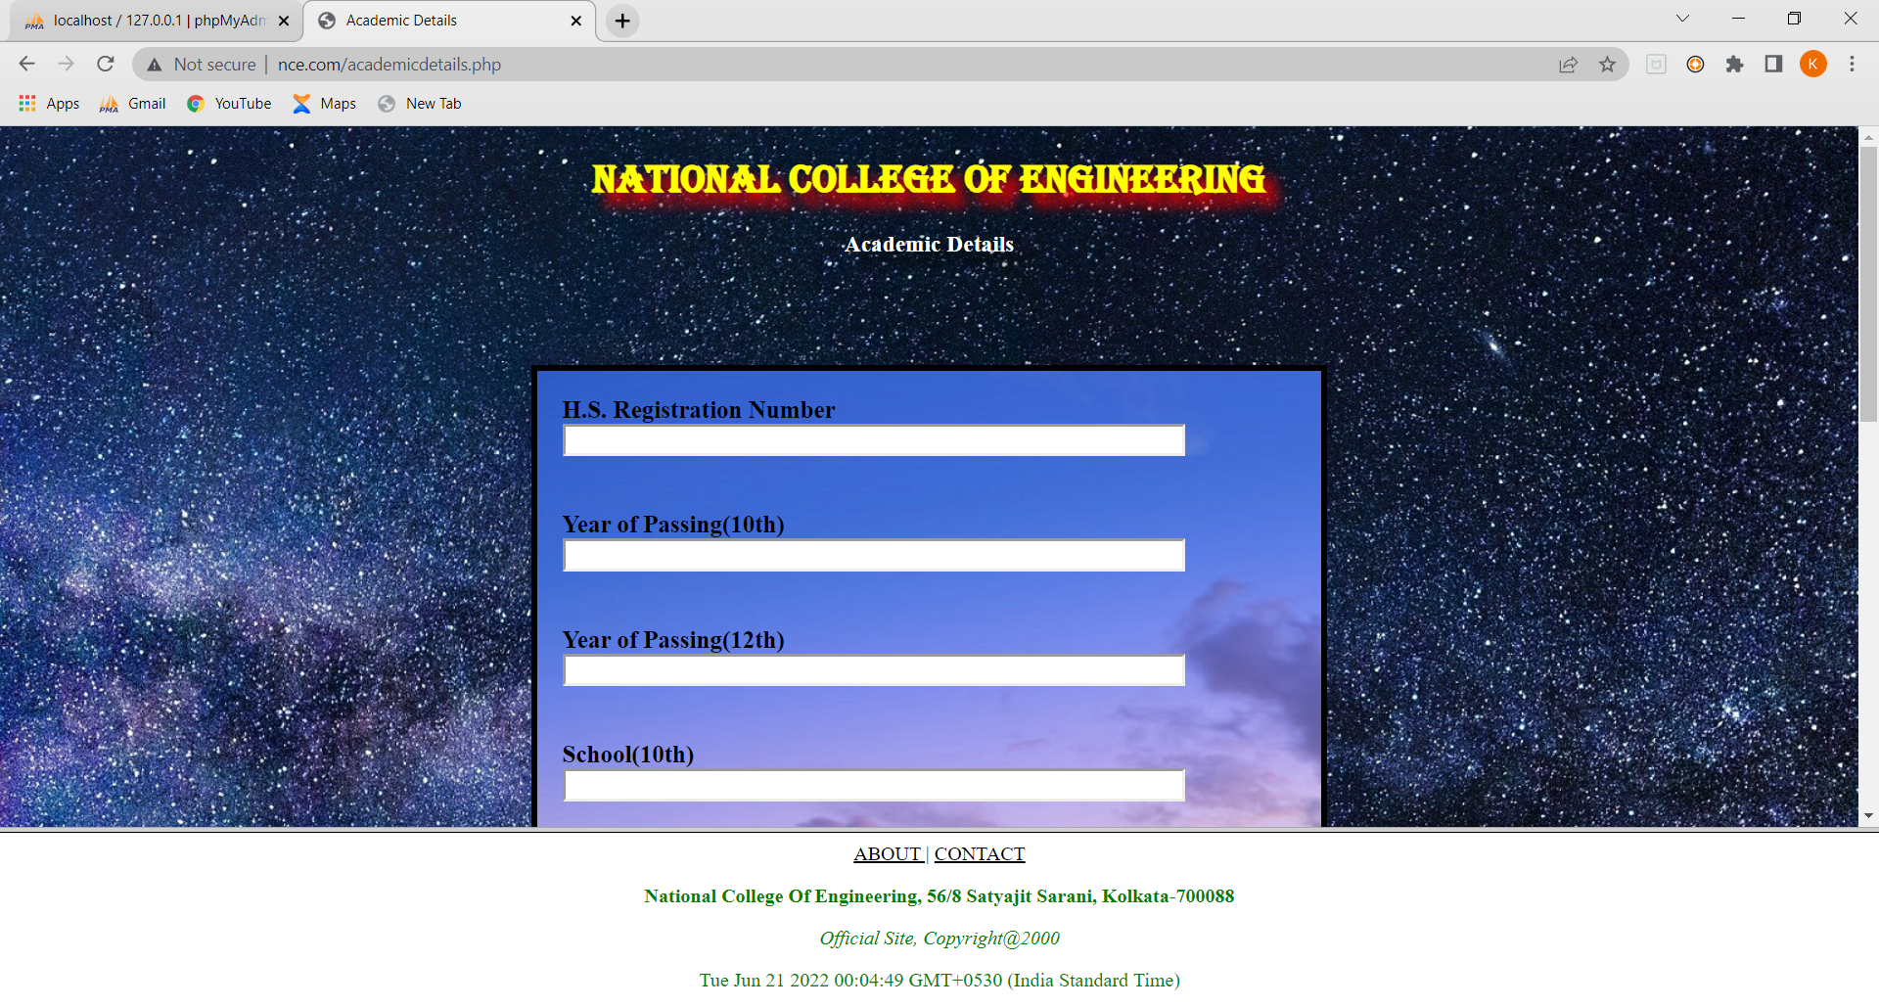
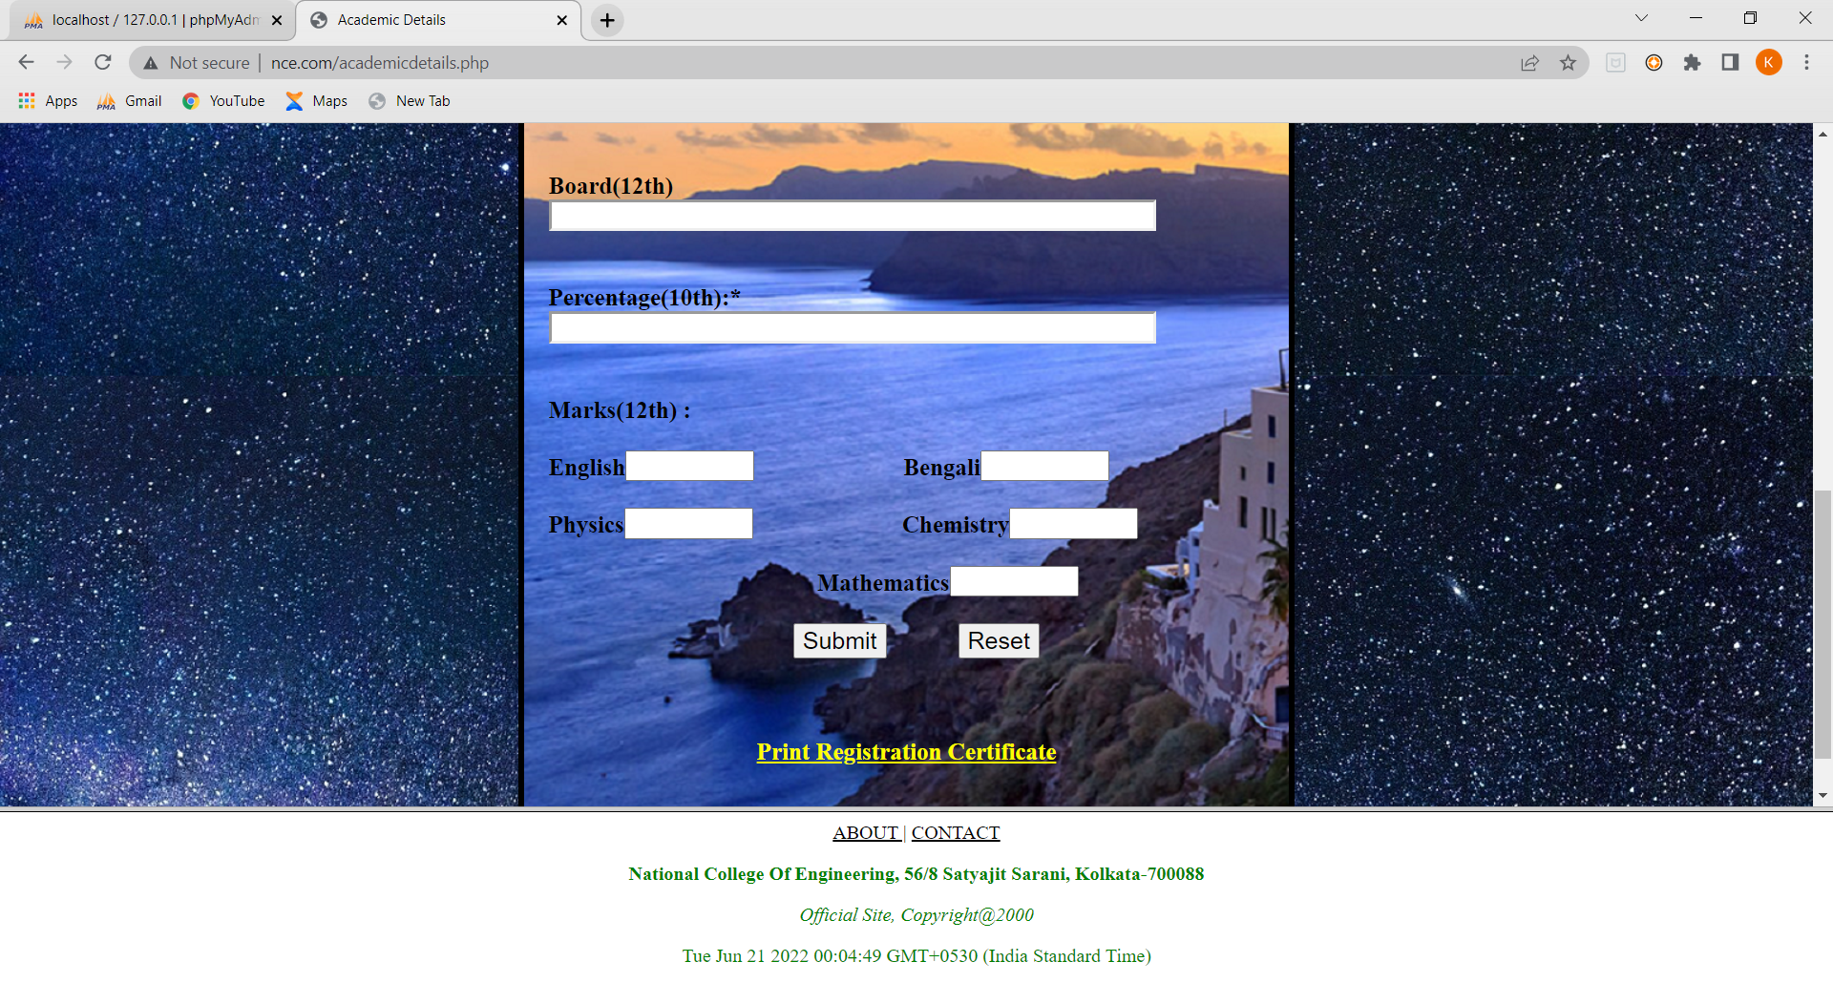
Academic Details
This webpage has been developed with HTML, CSS and JavaScript.
Several academic details data are to be asked from the user.
The details include H.S. Regno. , Year of passing, School, Board (10th &12th), 10th Percentage and subject marks of class 12
After clicking Submit button, all data would be uploaded to the Database.

Slide 5
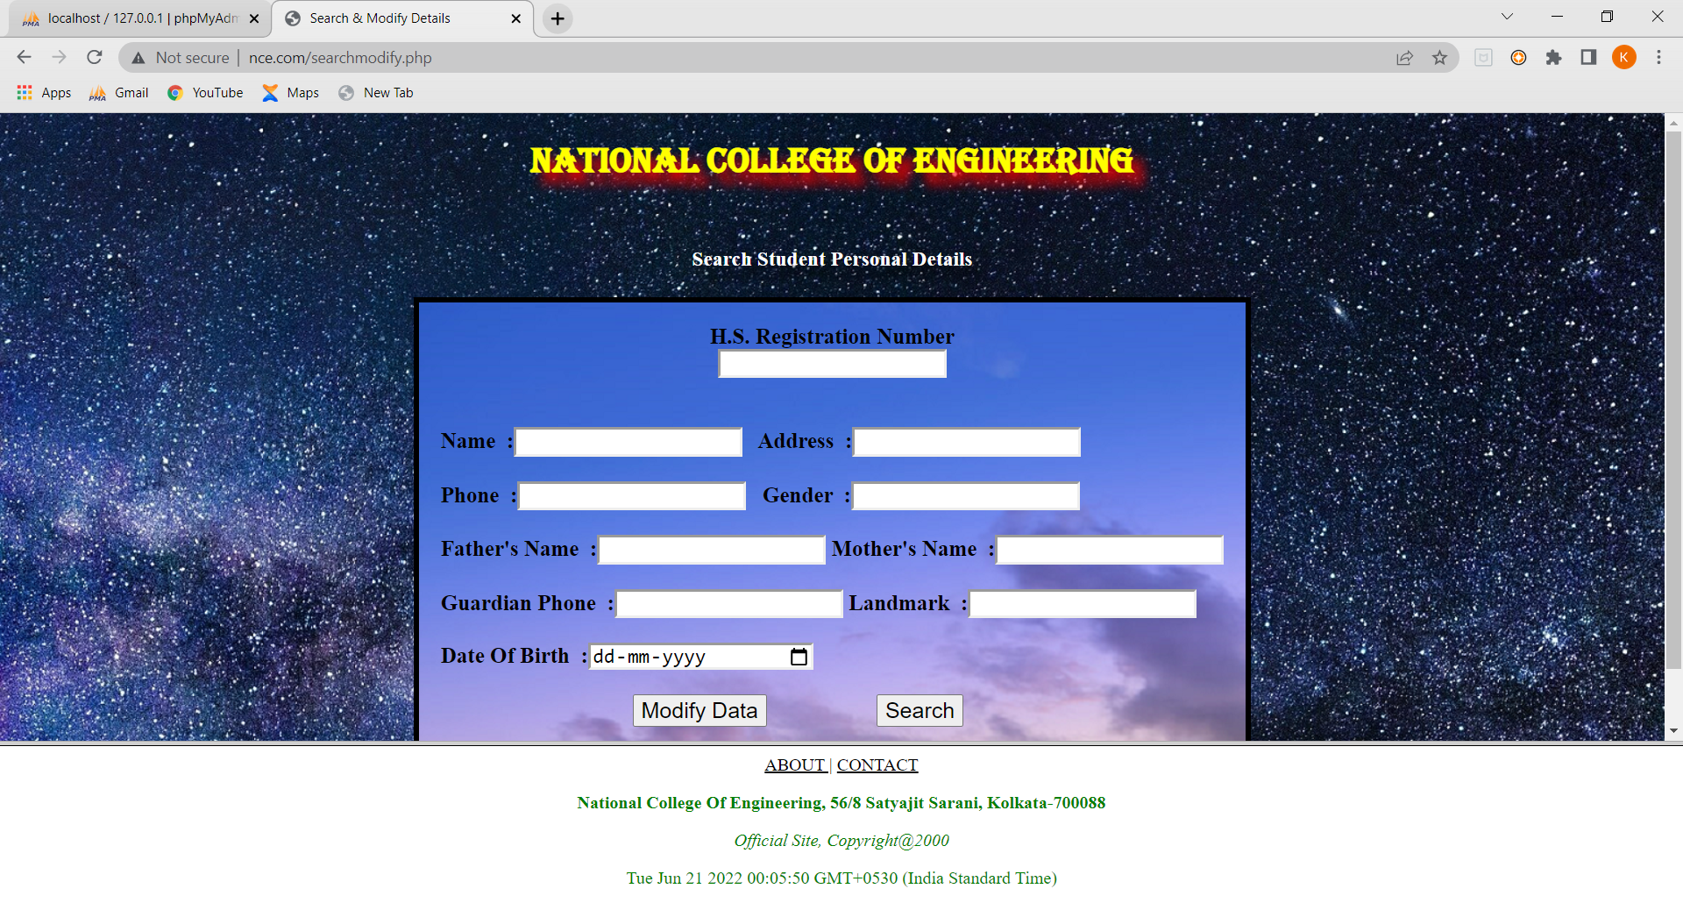
Search and Modify Personal Details
This webpage has been developed with HTML, CSS and JavaScript.
This webpage has been designed to search the personal details and update them in case of any errors at the previous stage.
The data required at the time of searching personal details is only the H.S. REGNO.
After clicking Search button, all personal data would be shown in screen, after changing the values the user required to click Modify Data to update data in Database.

Slide 6
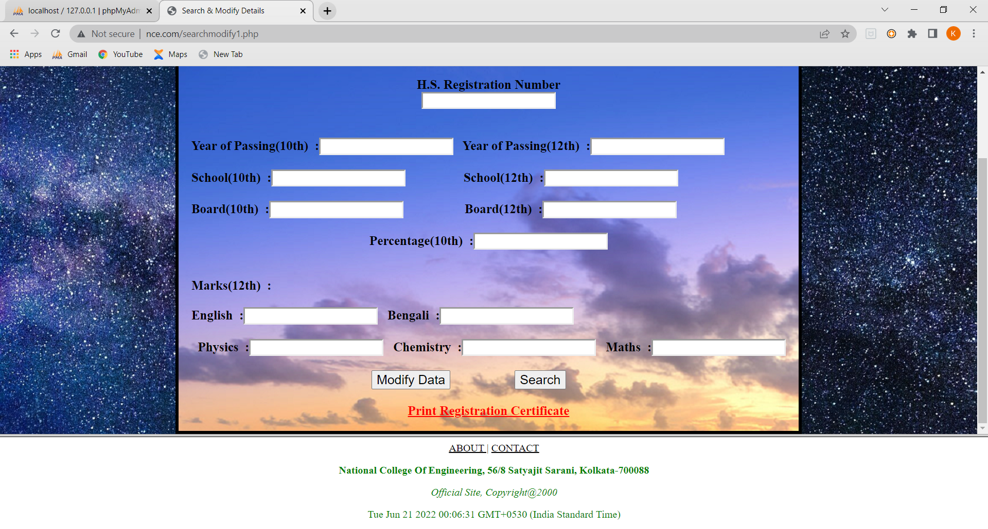
Search and Modify Academic Details
This webpage has been developed with HTML, CSS and JavaScript.
This webpage has been designed to search the Academic details and update them in case of any errors at the previous stage.
The data required at the time of searching academic details is only the H.S. REGNO.
After clicking Search button, all academic data would be shown in screen, after changing the values the user required to click Modify Data to update data in Database.

Slide 7
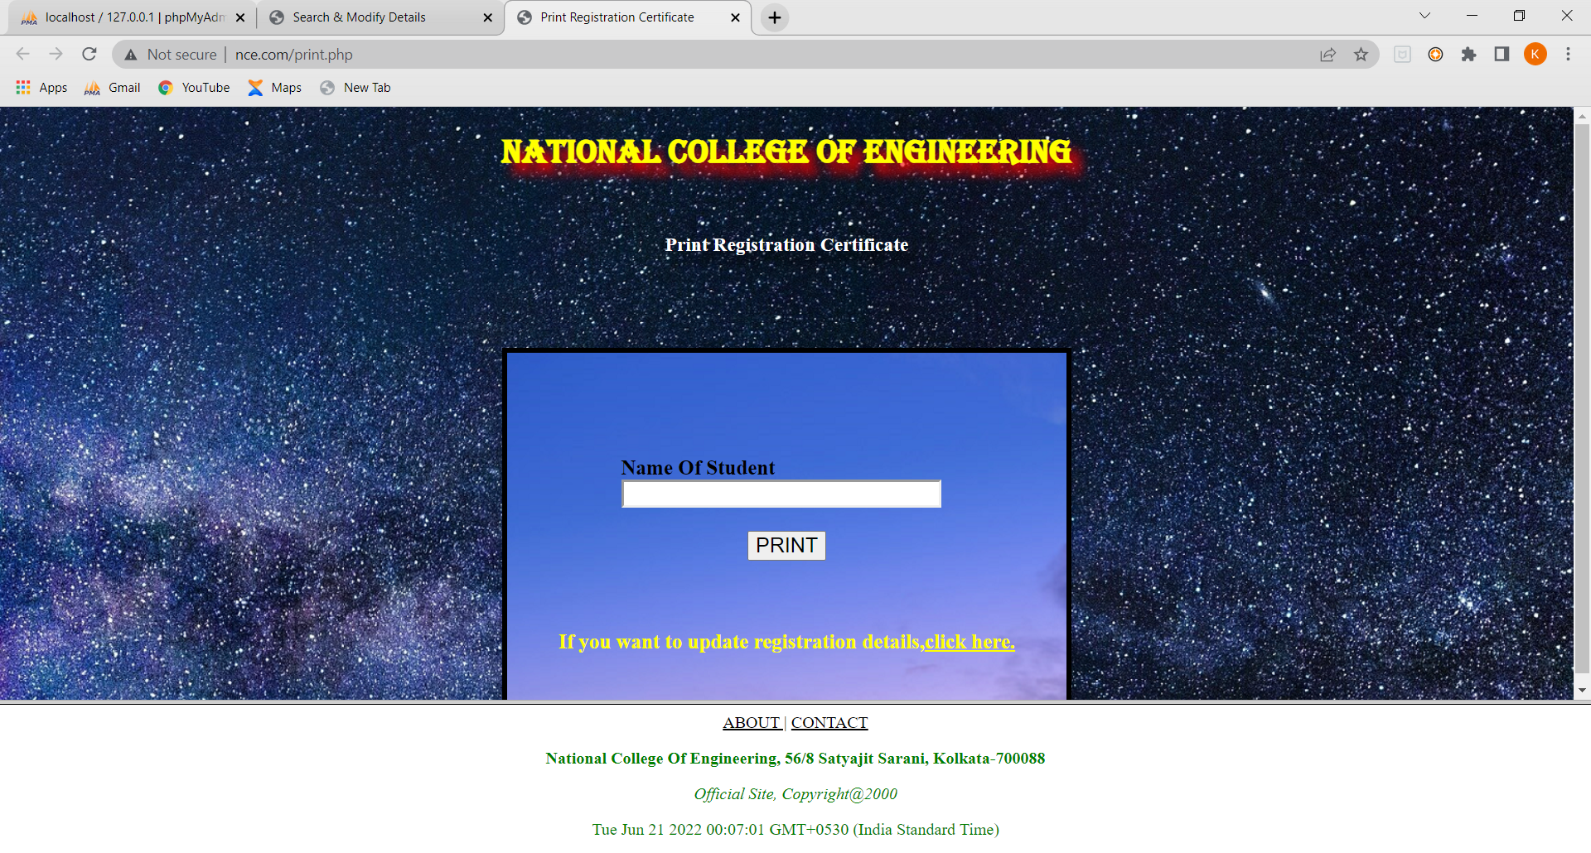
Print Registration Certificate
This webpage has been developed with HTML, CSS, JavaScript
After all data input, finally the user is asked to print his Registration Certificate
The data required to print user’s certificate is his NAME.
User can return to search and modify pages in case of any wrong inputs.

Slide 8

Registration Certificate The Final Output

Slide 9
STUDENT REGISTRATION WEBSITE LINK
http://studentreg690.000webhostapp.com/personaldetails.php

Slide 10
THANK YOU

